Slide 1
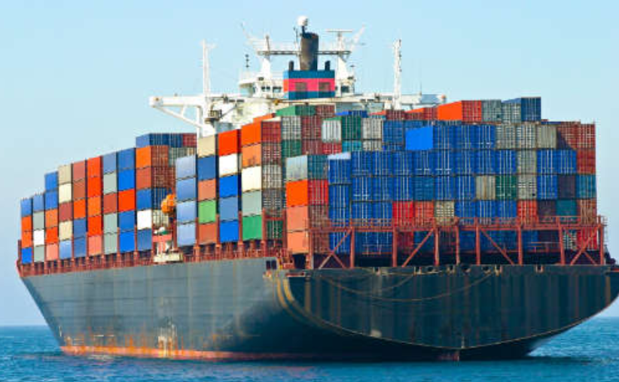
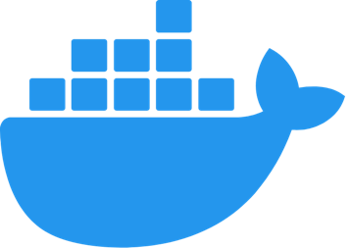

Demystifying Docker

Slide 2
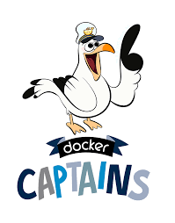




$whoami
Principal Development Engineer at DellEMC
1st half of my career was in CGI & VMware
2nd half of my career has been in System Integration Testing
Docker Captain (since 2016)
Docker Bangalore Meetup Organizer ( 7600+ Registered Users)
DockerLabs Incubator
Ajeet Singh Raina
Twitter: @ajeetsraina
GitHub: ajeetraina

Slide 3

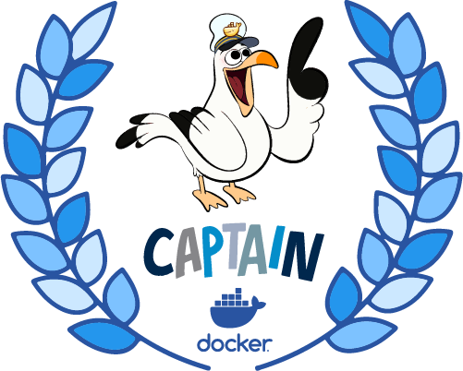
Ajeet Singh Raina
Tip of the Captains Hat Award
@ajeetsraina
Notes:
Ajeet Singh Raina won the 2019 Captains Hat Award. Be sure to follow him on twitter and check out his blog at http://collabnix.com/ for great Docker content and learning materials.

Slide 4
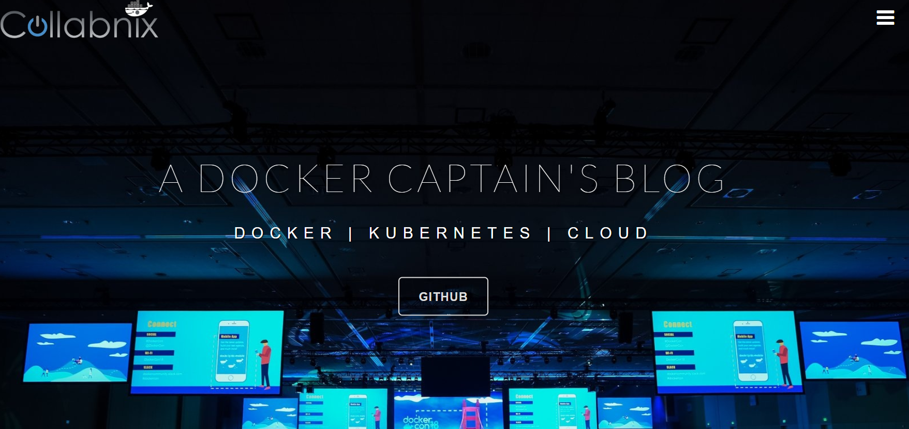
$curl www.collabnix.com

Slide 5
A Shift from Monolithic to Microservice Architecture

Slide 6
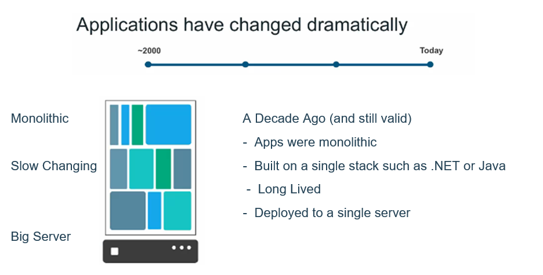

Slide 7
Let’s imagine you are building a large, complex application, e.g., Online Store

Slide 8
Successful Software Development
Architecture
Process
Organization

Slide 9
Successful Software Development
Architecture
Process
Organization
Small
Autonomous
team

Slide 10
Successful Software Development
Architecture
Process
Agile
Continuous Delivery
Organization
Small
Autonomous
team

Slide 11
Successful Software Development
Architecture
Monolthic Vs Microservices
Process
Agile
Continuous Delivery
Organization
Small
Autonomous
team

Slide 12
A Close Look at Monolithic
Storefront UI Module
Browser
HTML
Catalog
Module
Database
Client App
Reviews
Module
REST/JSON
Orders
Module
Notes:
Here’s my online store. As you can see its layered and modular. We have presentation layer exposing RESTAPI. Whenever the customer visit online store through browser in terms of HTML where he wants to just access the website OR might want to fetch information via RESTAPI.. There are various modules which implements different pieces of business functionality.

Slide 13
A Close Look at Monolithic
WAR
Storefront UI Module
Browser
HTML
Catalog
Module
Database
Client App
Reviews
Module
REST/JSON
Orders
Module
Tomcat
Notes:
But when we use monolithic approach, we package them up as a single application. Just a big monolithic application. IN Java world it would be WAR file.. The application uses a database. Inside Del, most of the application which we built has this architecture.

Slide 14
Benefits of Monolith
Simple to Develop, Test, Deploy & Scale
Simple to develop because of all the tools and IDEs support to that kind of application by default.
Easy to deploy because all components are packed into one bundle.
Easy to scale the whole application.

Slide 15
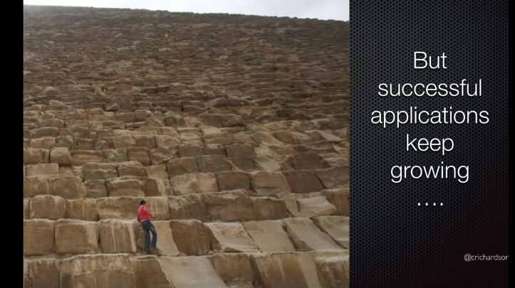

Slide 16
Disadvantages of Monolith
Very difficult to maintain
One component failure will cause the whole system to fail.
Very difficult to understand and create the patches for monolithic applications.
Adapting to new technology is very challengeable.
Take a long time to startup because all the components need to get started.
Notes:
Now online store became popular and grew with million of code

Slide 17





Customer/
Clients/ Users
Today
Apps are constantly developed
Built from loosely coupled components
Newer version are deployed often
- Deployed to a multitude of servers
Data Storage
Data Storage
Data Storage

Slide 18
Microservice Architecture
Storefront UI
Catalog
Service
Catalog Database
REST
HTML
API Gateway
Browser
REST
Reviews
Service
Reviews
Database
Order
Service
Order
Database
REST
Mobile Device
…
Service
…
Database
Notes:
What we saw previously as a single stack application now become standalone, composable services

Slide 19
Benefits of Microservices
Can scale independent microservices separately. No need to scale the whole the system
Can use the latest technologies to develop the microservices.
One component failure will not cause entire system downtimes.
When developing an overall solution we can parallel the microservices development task with the small teams. So it helps to decrease the development time.

Slide 20
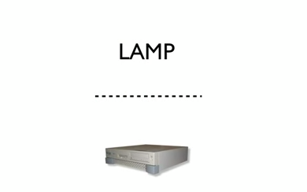
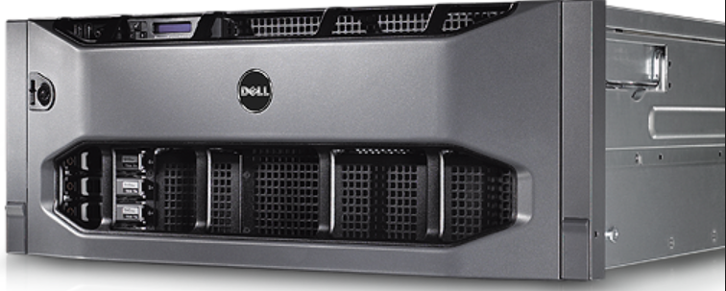
Once upon a time…a Software Stack

Slide 21
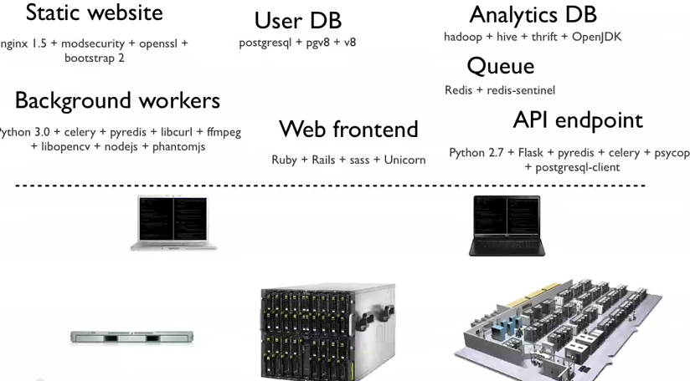
Now much more distributed & complex…

Slide 22
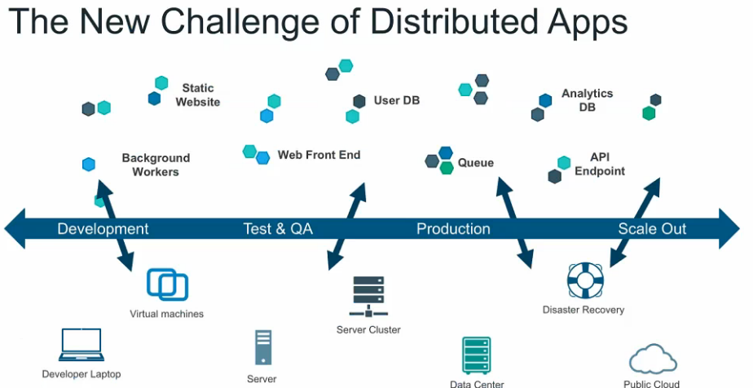

Slide 23
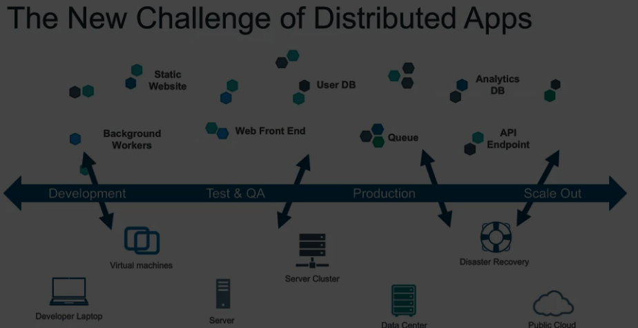
Shipping Code is damn too hard

Slide 24
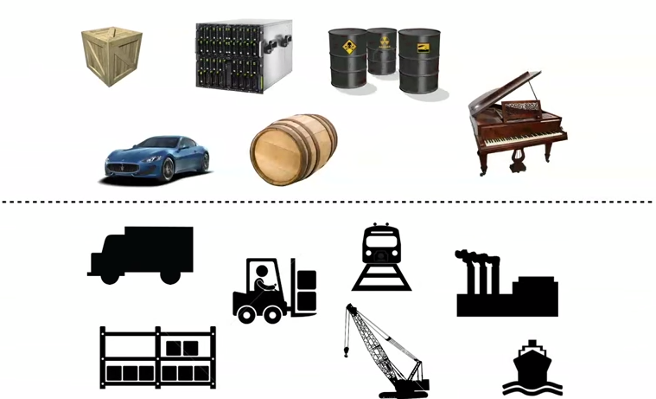
An Effort to solve the problem Complexity

Slide 25
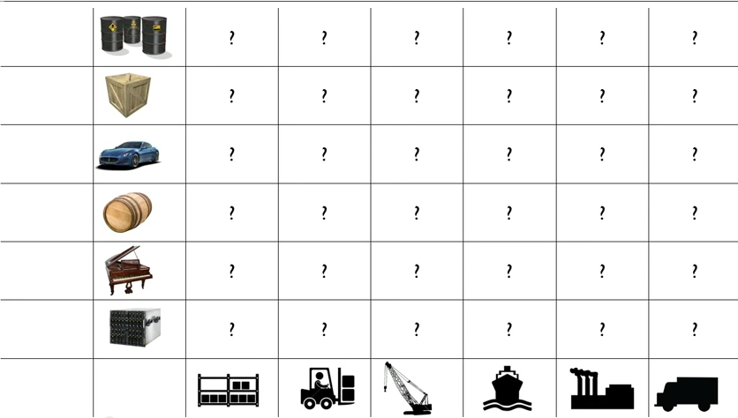
Every possible good to ship X Every Possible way to Ship

Slide 26
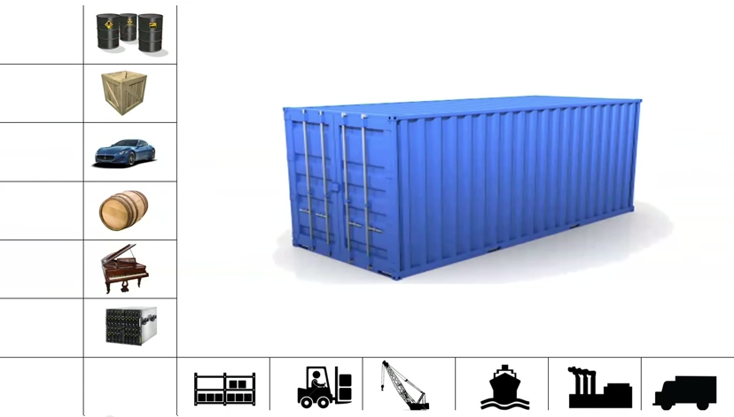
Enter….Internodal Container

Slide 27
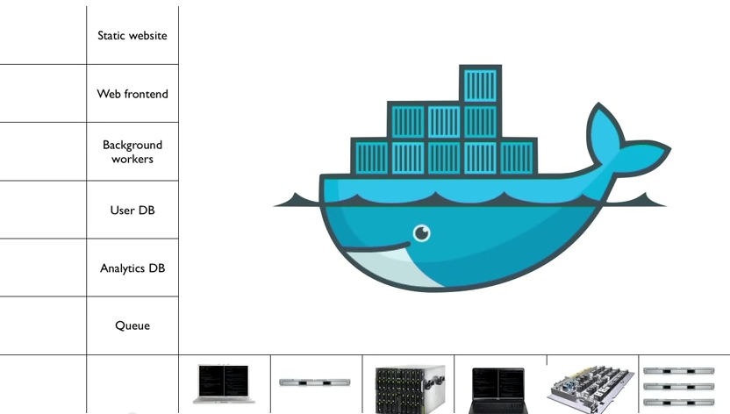
That’s what Docker is all about..

Slide 28
What is Docker and what problem does it solve?

Slide 29
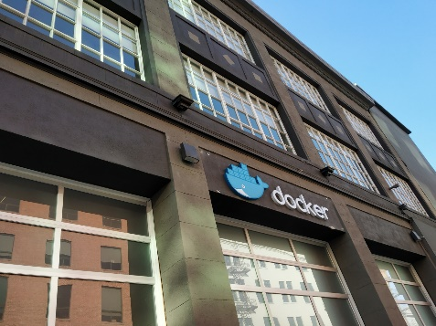

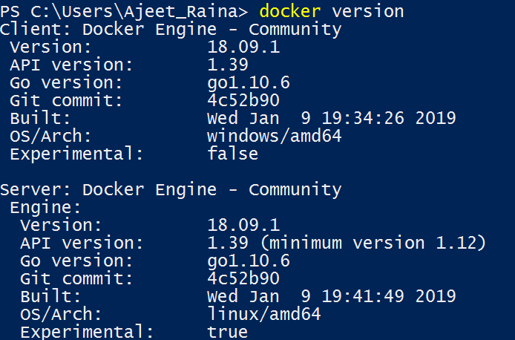
What is Docker?
Refers to several things in 2019
Docker as a “Company”
Docker as a “Product”
Docker as a “Platform”
Docker as a “CLI Tool”
Docker as a “Computer Program”

Slide 30
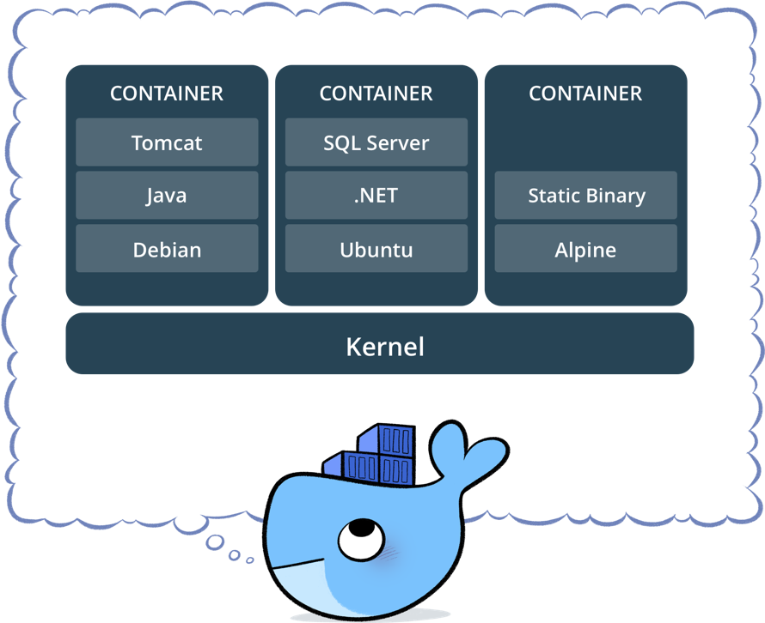
What is Docker?
Standardized packaging for software and dependencies
Isolate apps from each other
Share the same OS kernel
Works for all major Linux distributions
Containers native to Windows Server 2016 & 1809

Slide 31
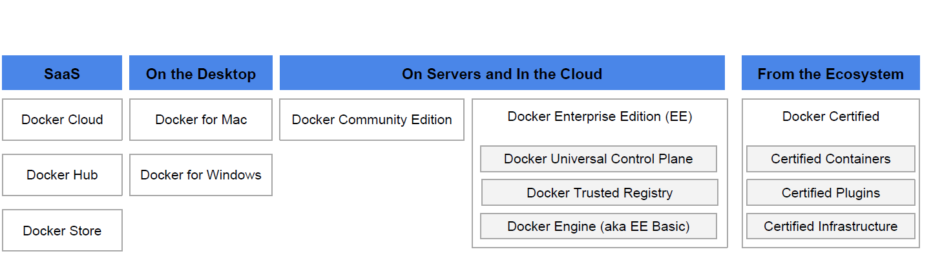

Docker Product Offerings

Slide 32
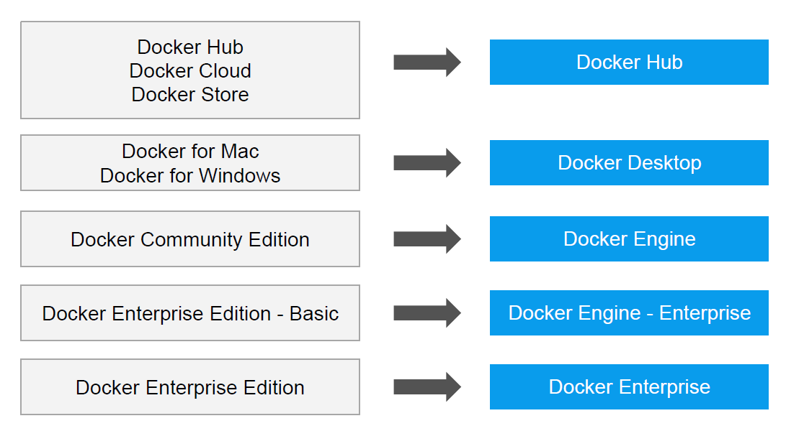

Slide 33
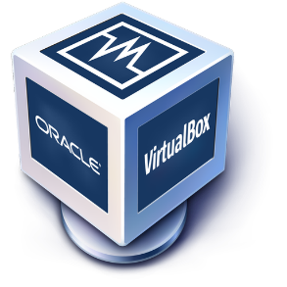
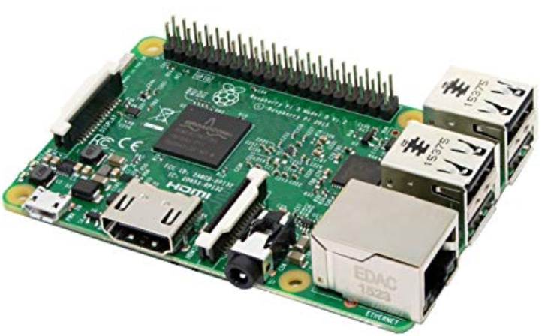
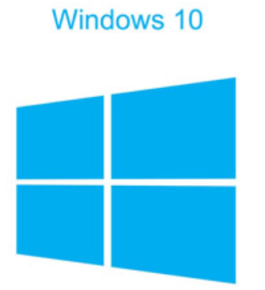


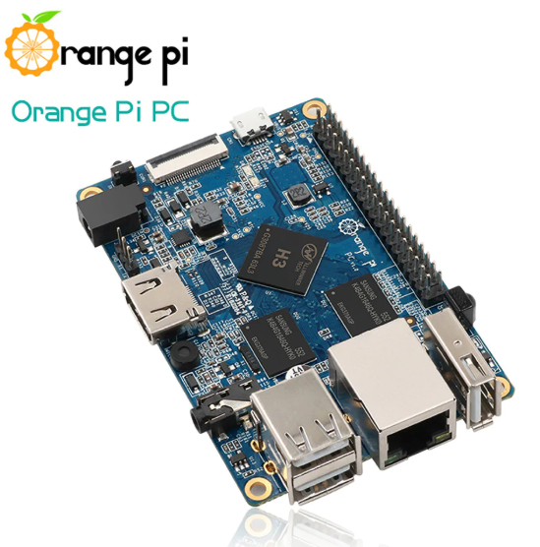

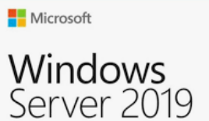



Today Docker runs on

Slide 34
Traditional Software Development WorkFlow
(without Docker)

Slide 35
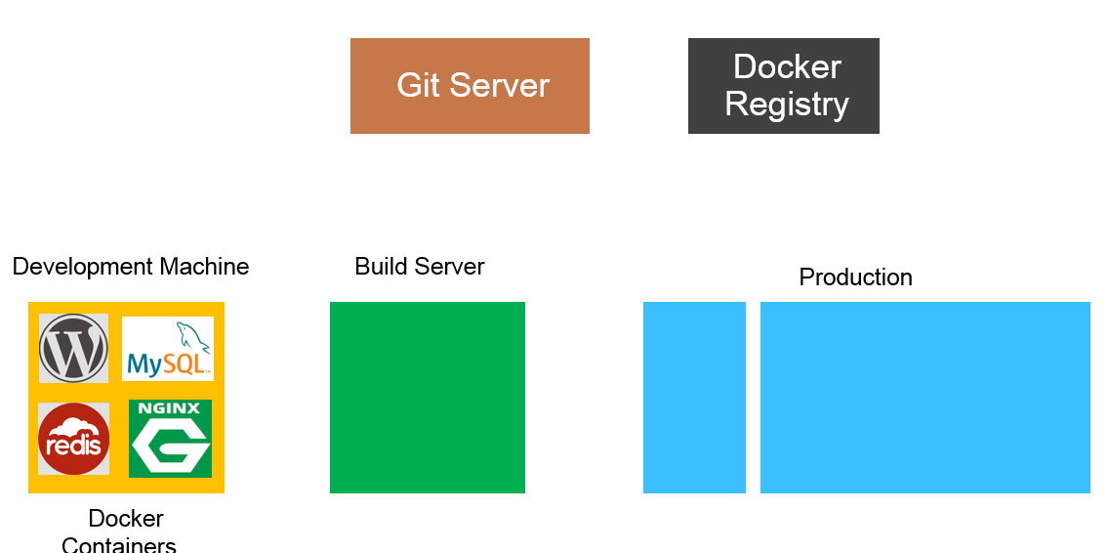


Slide 36
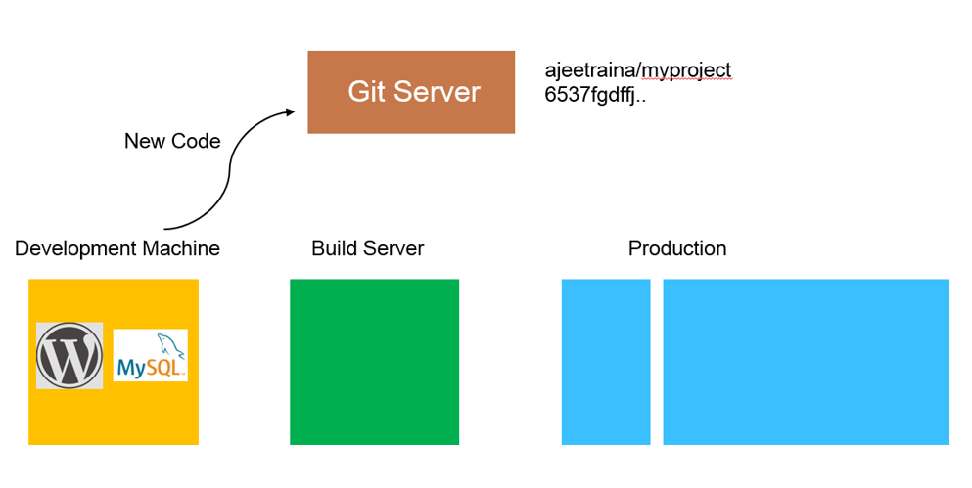

Slide 37
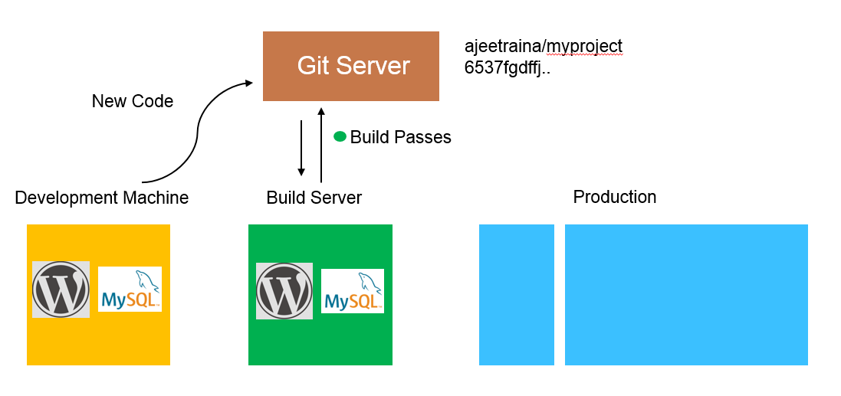

Slide 38
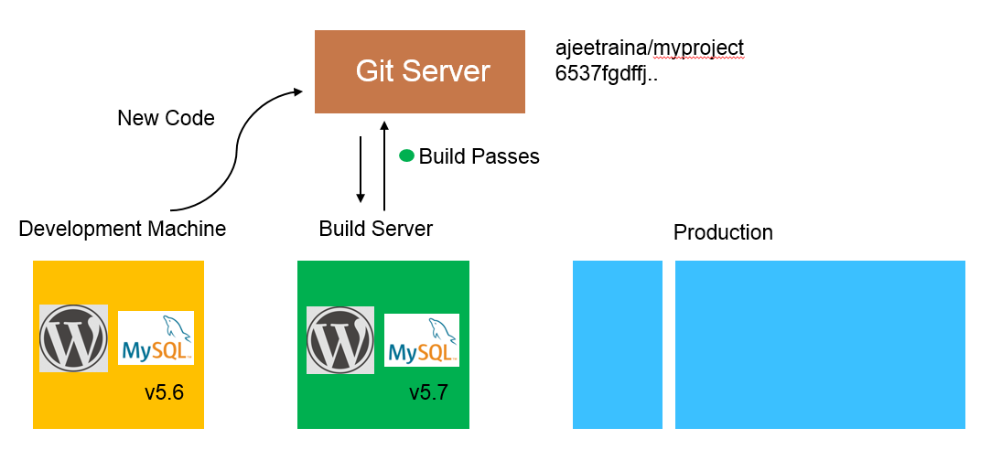

Slide 39
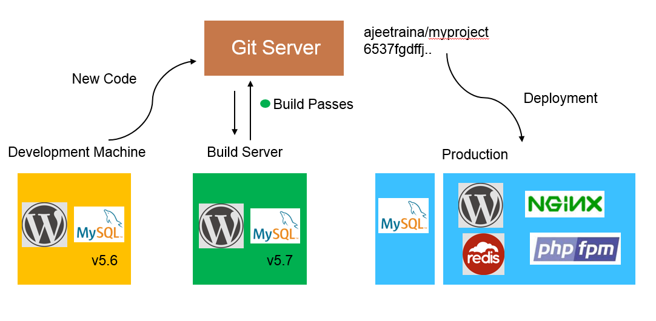

Slide 40
Traditional Software Development WorkFlow
(with Docker)

Slide 41
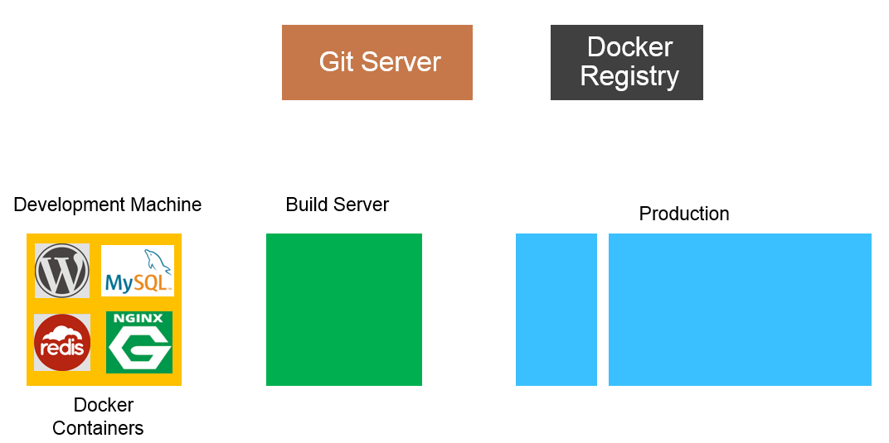

Slide 42
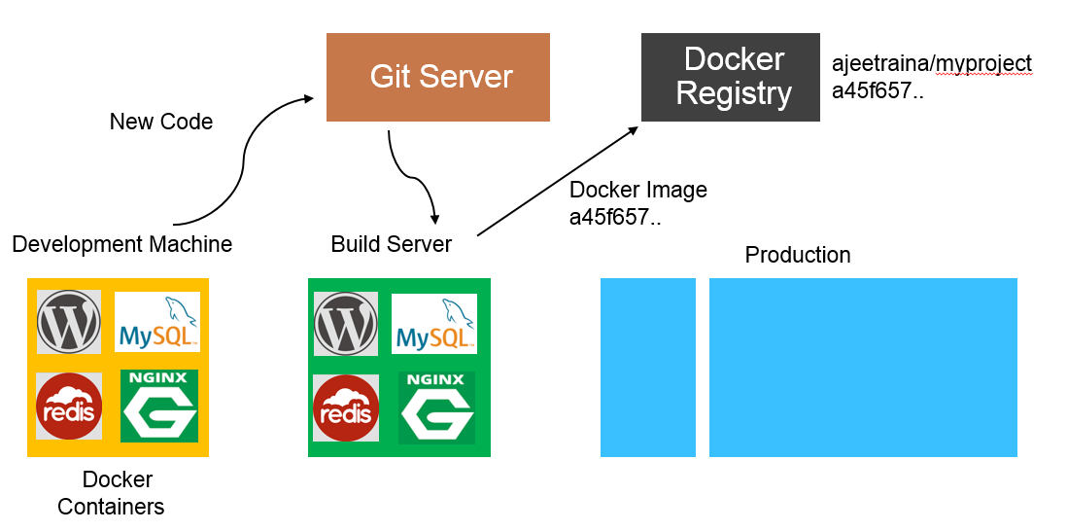

Slide 43
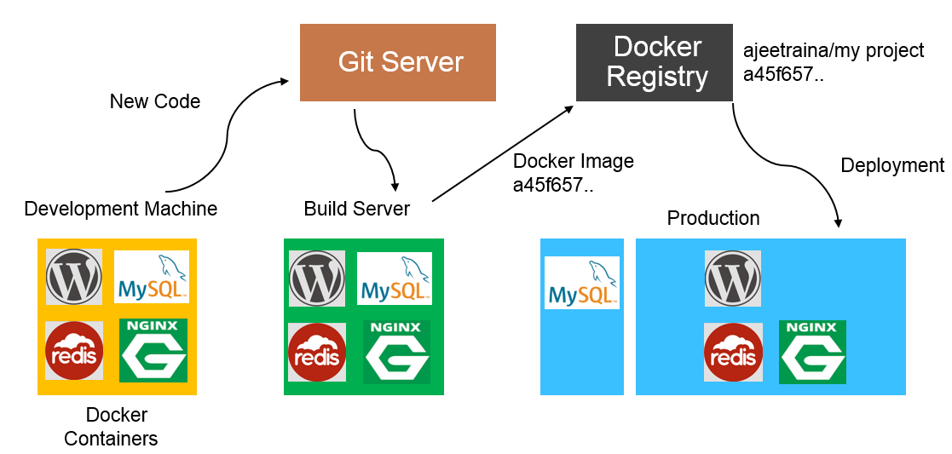

Slide 44
Docker Vs VM

Slide 45
Docker Containers are NOT VMs

Slide 46

Virtual Machine

Slide 47
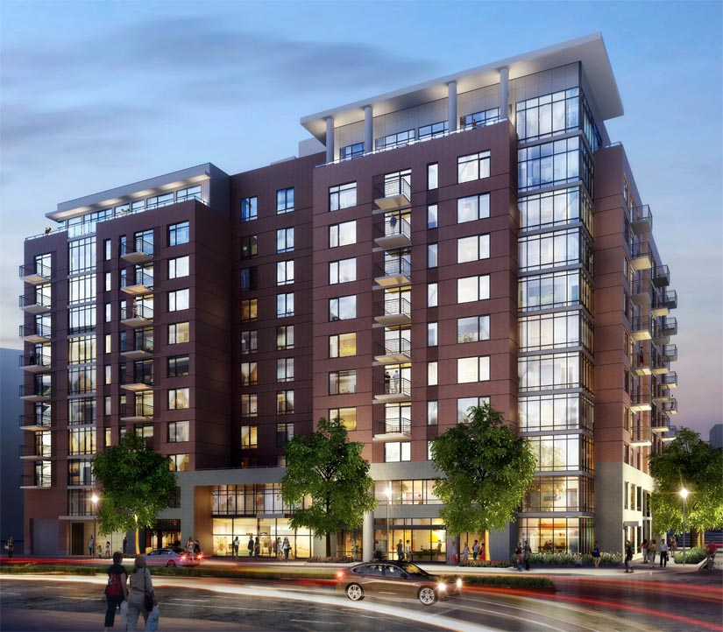
Containers

Slide 48
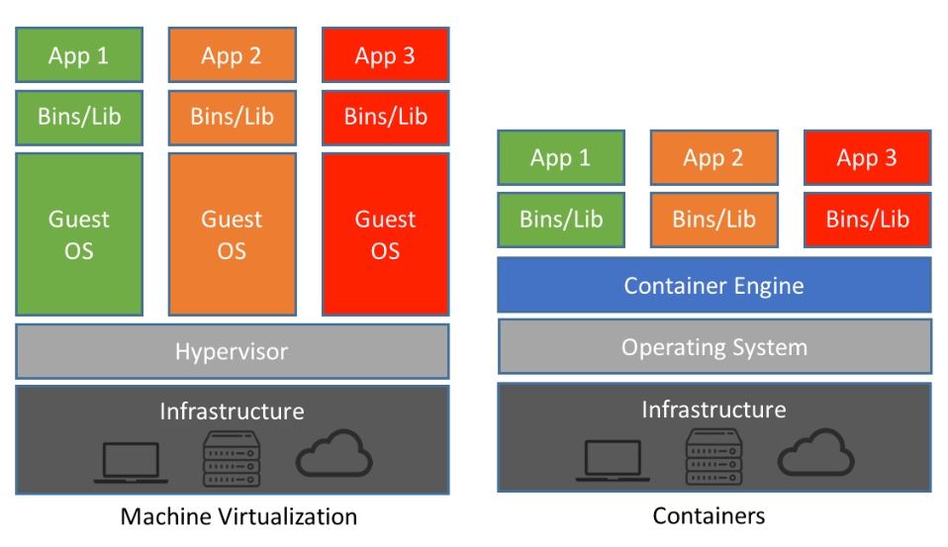
Docker Container Vs VM
Notes:
A container is similar to an application, which runs as a process on top of the operating system(OS) and isolates with each other by running in its own address space. Nevertheless, more than a normal process, a container not only includes the application executable, but also packs together all the necessary softwares that the application needs to run with, such as the libraries and the other dependencies. Cgroups [6] and namespaces [7] are two particular features that enables different containers running on the same physical machine. Cgroups, also named as control groups, is a Linux kernel mechanism to control the resources allocation. It allows

Slide 49
Comparing Docker & VM
Virtual Machines | Docker
Each VM runs its own OS | Container is just a user space of OS
Boot up time is in minutes | Containers instantiate in seconds
VMs snapshots are used sparingly | Images are built incrementally on top of another like layers. Lots of images/snapshots
Not effective diffs. Not version controlled | Images can be diffed and can be version controlled. Docker hub is like GITHUB
Cannot run more than couple of VMs on an average laptop | Can run many Docker containers in a laptop.
Only one VM can be started from one set of VMX and VMDK files | Multiple Docker containers can be started from one Docker image

Slide 50
What makes Containers so small?

Slide 51
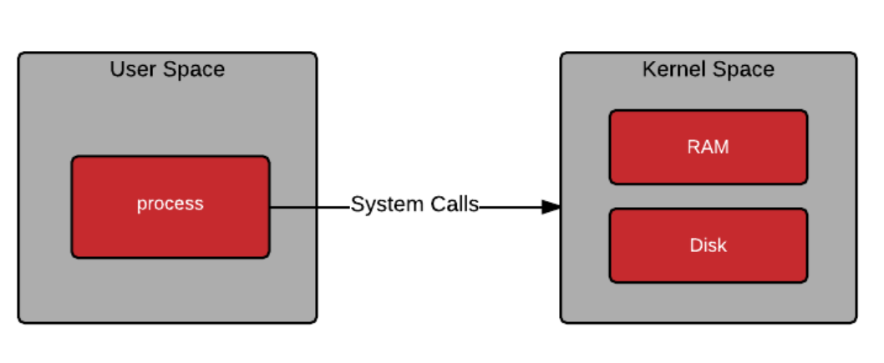
Container = User Space of OS
User space refers to all of the code in an operating system that lives outside of the kernel.
Process Virtualization
Notes:
The kernel provides an API to these applications via system calls.
OK, so you understand what a process is, and that containers are processes, but what about the files and programs that live inside a container image? These files and programs make up what is known as user space. When a container is started, a program is loaded into memory from the container image. Once the program in the container is running, it still needs to make system calls into kernel space. The ability for the user space and kernel space to communicate in a deterministic fashion is critical.
User Space
User space refers to all of the code in an operating system that lives outside of the kernel. Most Unix-like operating systems (including Linux) come pre-packaged with all kinds of utilities, programming languages, and graphical tools - these are user space applications. We often refer to this as “userland.”

Slide 52
Demonstrating Process Virtualization

Slide 53
Demonstration Process Virtualization
Notes:
docker inspect --format '{{.State.Pid}}

Slide 54
Docker Engine Architecture

Slide 55
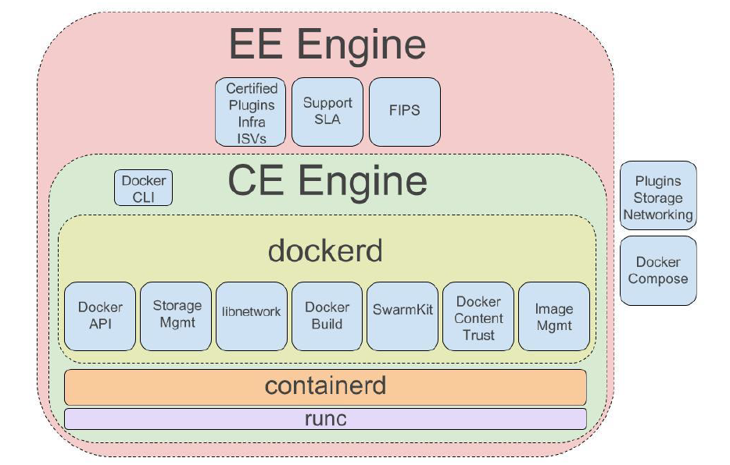
Docker Engine Architecture

Slide 56
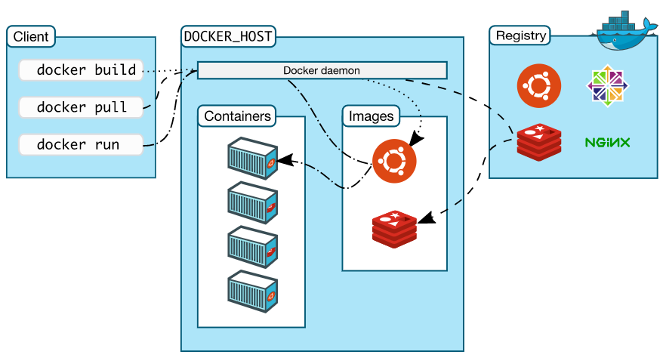
Notes:
Docker uses a client-server architecture. The Docker client talks to the Docker daemon, which does the heavy lifting of building, running, and distributing your Docker containers. The Docker client and daemon can run on the same system, or you can connect a Docker client to a remote Docker daemon. The Docker client and daemon communicate using a REST API, over UNIX sockets or a network interface.

Slide 57
Docker Vocabulary

Slide 58
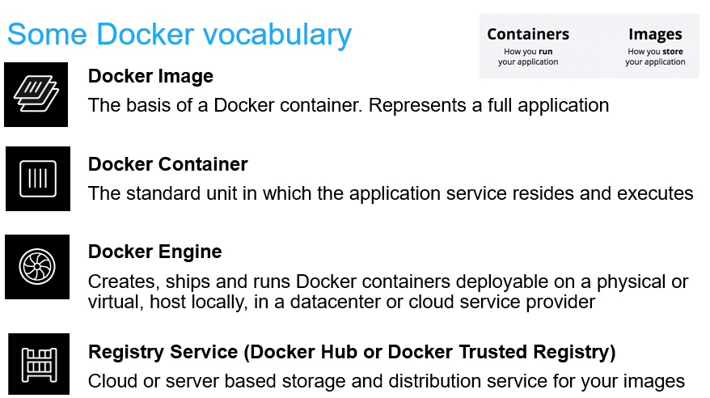

Slide 59
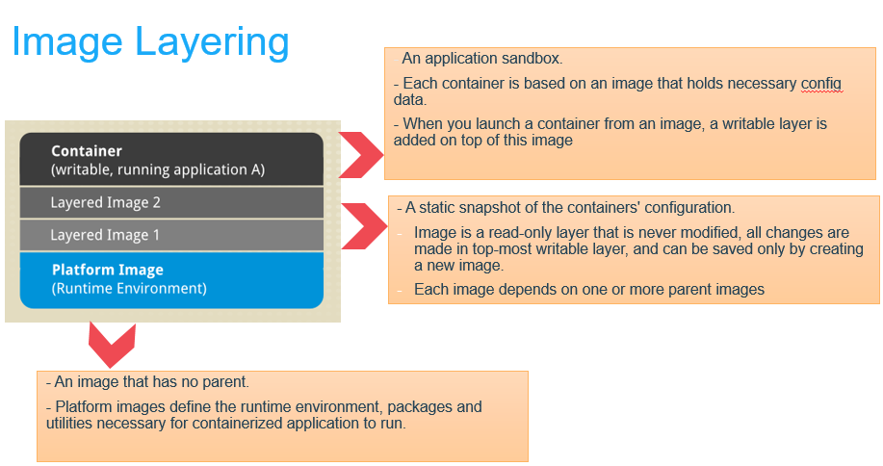

Slide 60
Image Layers
…
Install Requirements
Copy Requirements
Upgrade Pip
Install Python and Pip
Alpine Linux
Kernel

Slide 61
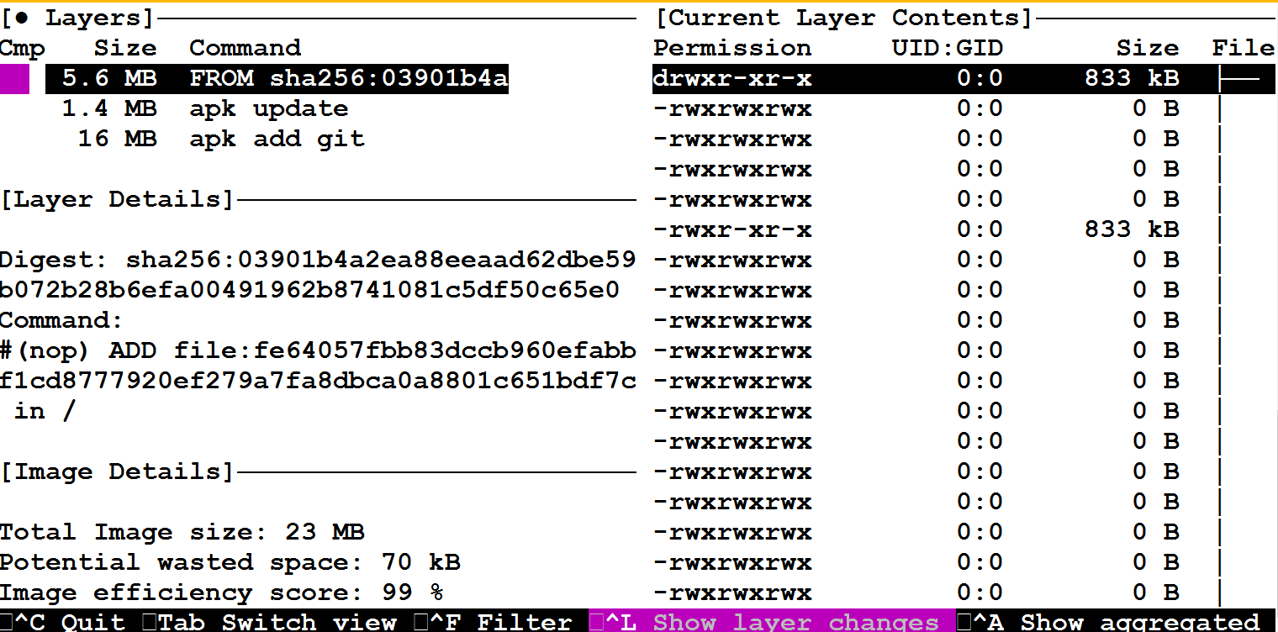
A Look at “Dive” Tool
A tool for exploring each layer in a Docker image
https://github.com/wagoodman/dive

Slide 62
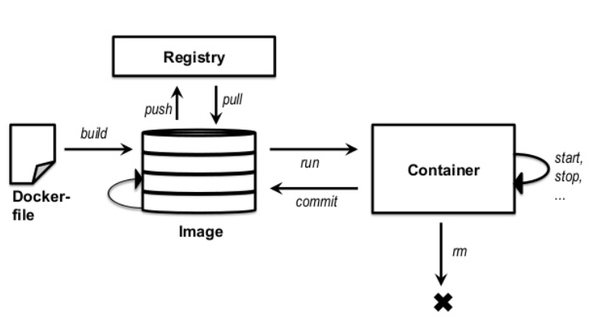
Basic Docker CLIs
Pulling Docker Image
$ docker pull ajeetraina/hellowhale
Listing out Docker Images
$ docker image ls
Running Docker Containers $ docker run –d –p 5000:5000 –-name hellowhale ajeetraina/hellowhale
Stopping the container
$ docker stop hellowhale (or <container id>)

Slide 63
Docker Desktop Community Vs Docker Enterprise

Slide 64

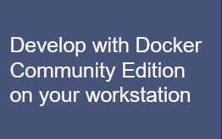
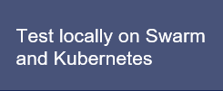


Docker Community Edition
All in one development for Swarm and Kubernetes

Slide 65
Docker Desktop Community Vs Enterprise
 | Docker Desktop Community | Docker Desktop Enterprise
Simplest Path to Container-based Development
Latest Docker Engine Based on Containerd
Certified Kubernetes
Available for Windows 10 & MacOS
Develop in any Language & Framework, even multiple versions simultaneously
Notes:
Docker Announces Docker Desktop Enterprise for Building and Deploying Container-based Solutions with Enterprise-Grade Security and Manageability
New desktop application provides developers and IT the easiest, fastest and most secure way to deliver containerized applications from development to production
a new desktop product that is the e
Enterprise Manageability That Helps Accelerate Time-to-Production
asiest, fastest and most secure way to deliver enterprise production-ready containerized applications

Slide 66
Docker Desktop Community Vs Enterprise
 | Docker Desktop Community | Docker Desktop Enterprise
Production-Ready Environment
Same API & Commands shared by Developers in Production
Application Designer interface to simplify creating & developing Docker applications
Swappable Docker Engine and Kubernetes versions to match Docker Enterprise production environments
Notes:
The Application Designer is a new workflow that provides production-ready application and service templates that let you get coding quickly, with the reassurance that your application meets architectural standards. And even if you’ve never launched a container before, the Application Designer interface provides the foundational container artifacts and your organization’s skeleton code, getting you started with containers in minutes. Plus, Docker Desktop Enterprise integrates with your choice of development tools, whether you prefer an IDE or a text editor and command line interfaces.

Slide 67
Using Docker – Build, Ship & Run WorkFlow

Slide 68
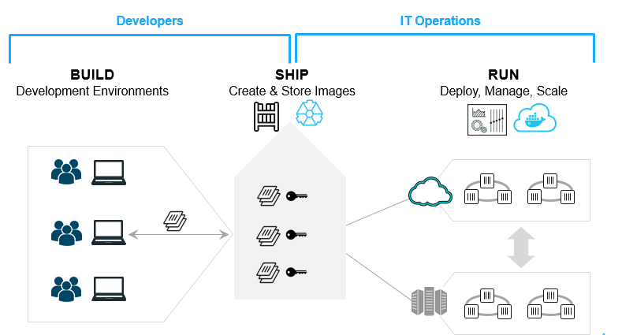
Build. Ship. Run.

Slide 69
Create DockerHub Account(if not completed)
Open https://play-with-docker.com
Hello Whale Example
Build Your First Docker Image & Push it to DockerHub
Demo

Slide 70
Docker New CLI Plugin

Slide 71
Docker New CLI Plugin
Plugins | Delivery Vehicle | Availability
app | 19.03-ce, 19.03-ee, Desktop CE, Desktop EE | Available now via Engine Community and Desktop Community (Mac | Windows) Docker Enterprise 3.0
assemble | 19.03-ee, Desktop Enterprise | Available with Docker Enterprise 3.0
template | 19.03-ee, Desktop Enterprise | Available with Docker Enterprise 3.0
cluster | 19.03-ee, Desktop Enterprise | Available with Docker Enterprise 3.0
gmsa | 19.03-ee, Desktop Enterprise | Available with Docker Enterprise 3.0
registry | 19.03-ee, Desktop Enterprise | Available with Docker Enterprise 3.0
buildx | desktop-edge | Available in Desktop CE Edge (Mac | Windows), download the plugin
jump | Sign up for more information | Sign up for more information
pipeline | Sign up for more information | Sign up for more information

Slide 72
Building Docker Containers & Microservices

Slide 73
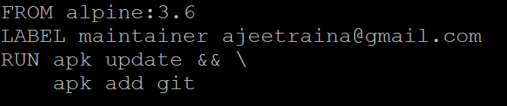
Introducing Dockerfile
Series of instructions to build Docker Images
Notes:
A Dockerfile is a text document that contains all the commands a user could call on the command line to assemble an image
Docker builds images automatically by reading the instructions from a Dockerfile

Slide 74
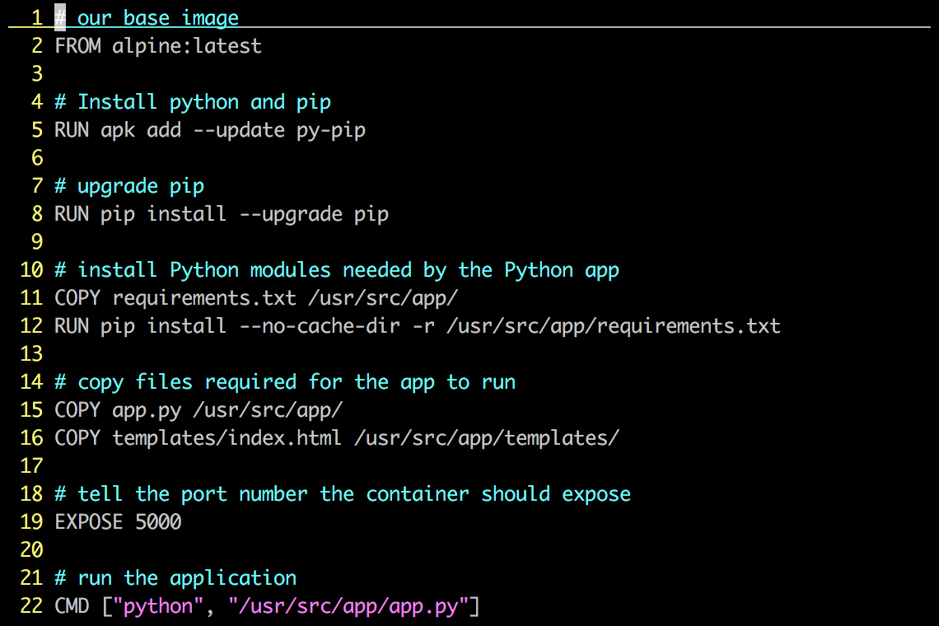
Dockerfile – Example

Slide 75
Each Dockerfile creates a Layer
…
Install Requirements
Copy Requirements
Upgrade Pip
Install Python and Pip
Alpine Linux
Kernel

Slide 76
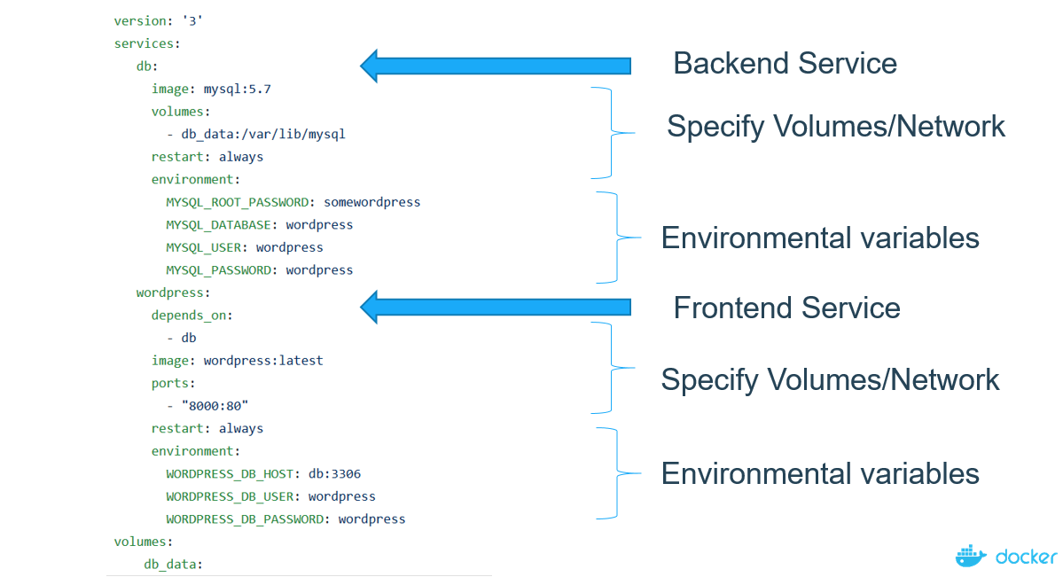
Docker Compose
Compose is a tool for defining and running multi-container Docker applications
Notes:
Compose is a tool for defining and running multi-container Docker applications

Slide 77
Demo
- Running WordPress Application using Docker Compose

Slide 78
How can I contribute?

Slide 79
$open dockerlabs.collabnix.com

Slide 80
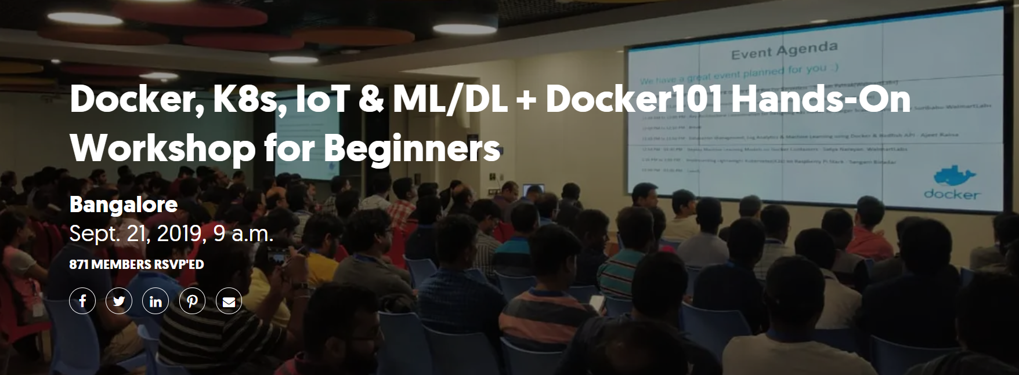
Upcoming Event

Slide 81
Reference
https://github.com/collabnix/dockerlabs
https://docs.docker.com
http://www.collabnix.com

Slide 82




Thank You

